Slide 1
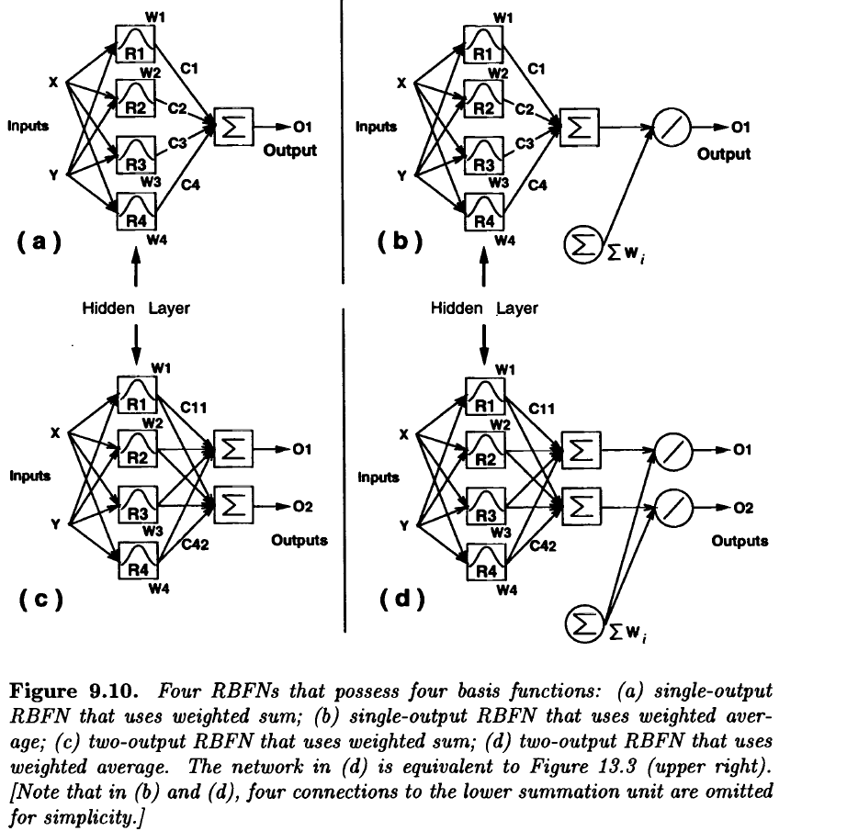

Slide 2
Genetic Algorithm
-are derivative free stochastic optimization method based loosely on the concept of natural selection and evolution process.
Characteristics:
GA are parallel search procedures that can be implemented on parallel processing machines for massively speeding up their operations.
GA are applicable to both continuous and discrete optimization problems.
GA are stochastic and less likely to get trapped in local minima, which inevitably are present in any practical optimization application.
GA flexibility facilitates both structure and parameter identification in complex modules such as neural nets FIS.
GA encode each point in a parameter(or solution) space into a binary bit string called chromosome, and each point is associated with a “fitness” value that, for maximization, is usually equal to the objective function evaluated at the point.
GA usually keep a set of points as a population(or gene pool).
In each generation, the GA constructs a new population using genetic operations such as crossover and mutation.
Memebers with high fitness values are more likely to service and to participate in mating (crossover) operations.

Slide 3
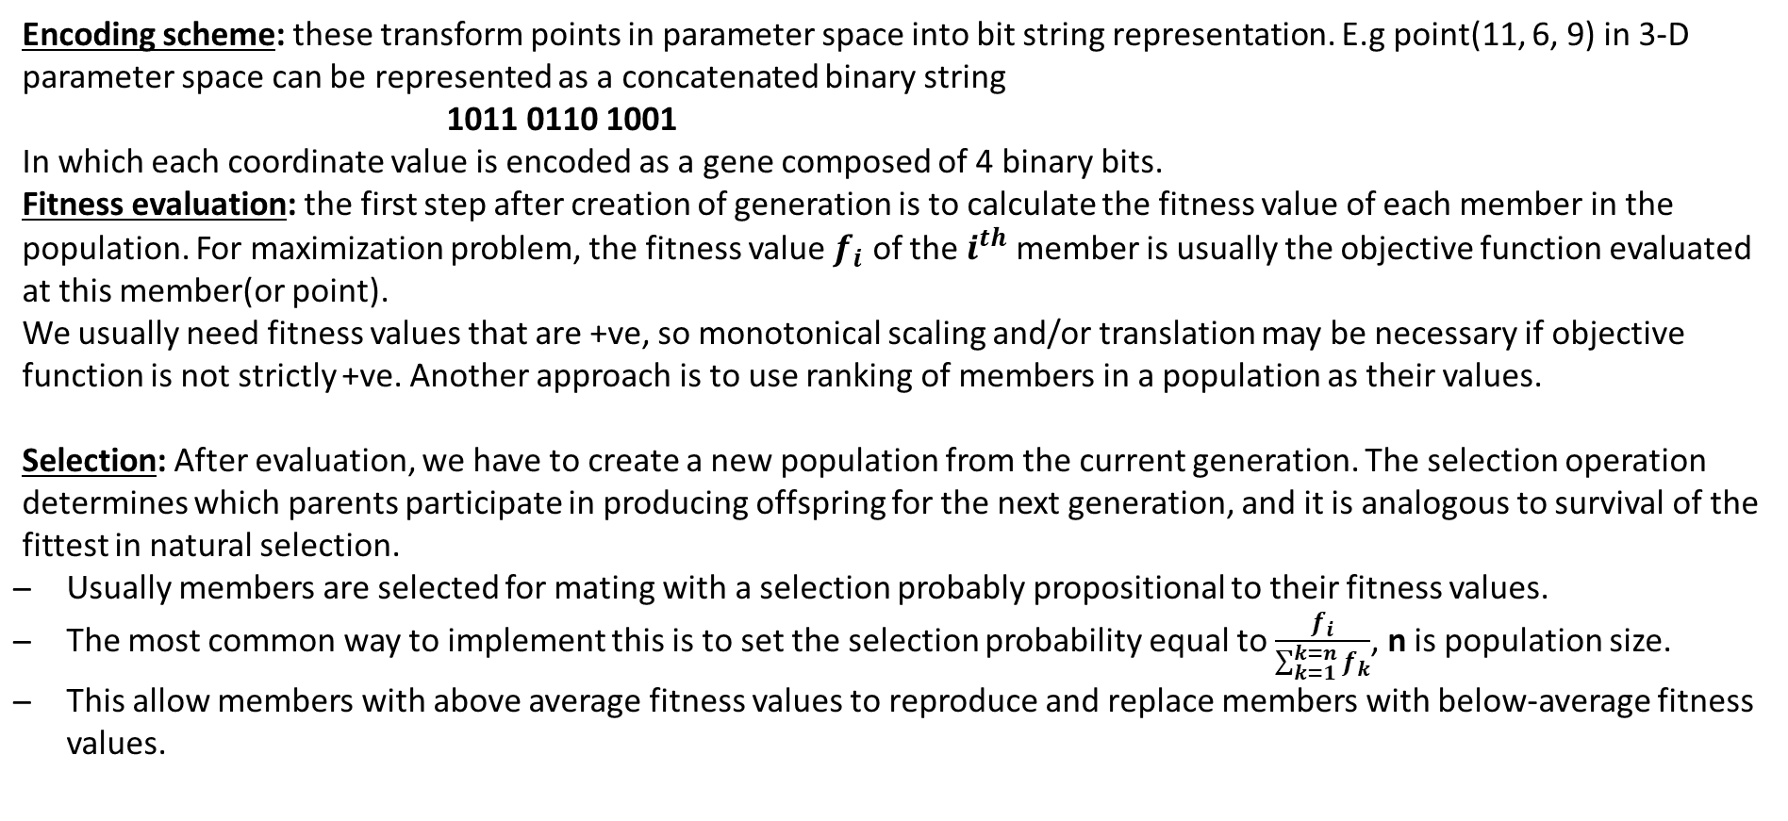
Major Components of GA
Encoding scheme: these transform points in parameter space into bit string representation. E.g point(11, 6, 9) in 3-D parameter space can be represented as a concatenated binary string
1011 0110 1001
In which each coordinate value is encoded as a gene composed of 4 binary bits.
Fitness evaluation: the first step after creation of generation is to calculate the fitness value of each member in the population. For maximization problem, the fitness value $f_{i}$ of the $i^{th}$ member is usually the objective function evaluated at this member(or point).
We usually need fitness values that are +ve, so monotonical scaling and/or translation may be necessary if objective function is not strictly +ve. Another approach is to use ranking of members in a population as their values.
Selection: After evaluation, we have to create a new population from the current generation. The selection operation determines which parents participate in producing offspring for the next generation, and it is analogous to survival of the fittest in natural selection.
Usually members are selected for mating with a selection probably propositional to their fitness values.
The most common way to implement this is to set the selection probability equal to $\frac{f_{i}}{\sum_{k=1}^{k=n}{f_{k}}}$, n is population size.
This allow members with above average fitness values to reproduce and replace members with below-average fitness values.

Slide 4
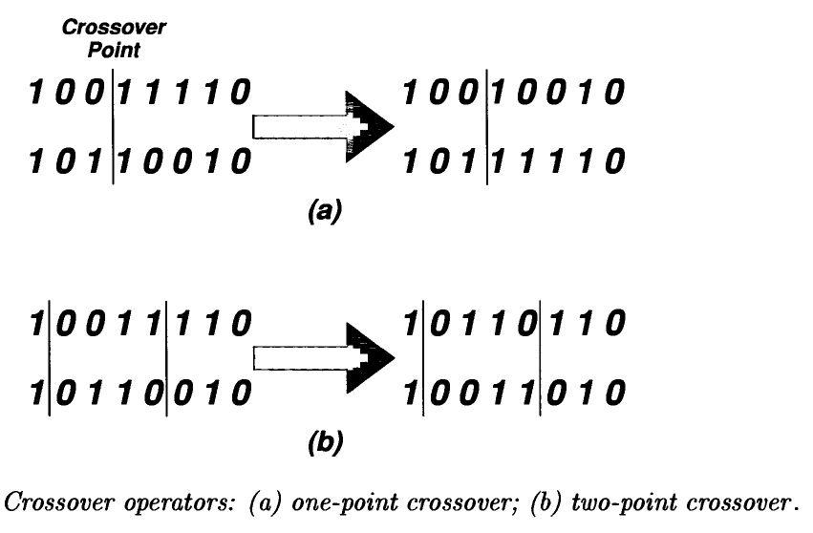
Crossover: the cross is applied to selected pairs of parents with a probability equal to a given crossover rate. One-point crossover in where a crossover point on the genetic code is selected at random and two-point chromosomes are interchanged at this point.
-In two-point crossover, two crossover points are selected and the point of the chromosome string between these 2 points is then swapped to generate two children. We define n-point crossover similarly.
Mutation: Crossover exploits current gene potentials, but if the population does not contain all the encoded information needed to solve a problem, no amount of gene mixing can be producing a satisfactory solution. For this reason, a mutation operators capable of spontaneously generating new chromosomes is included.

Slide 5
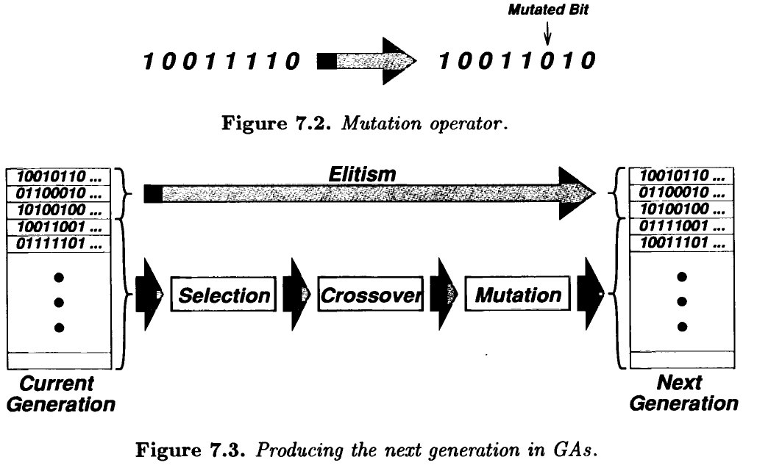

Slide 6
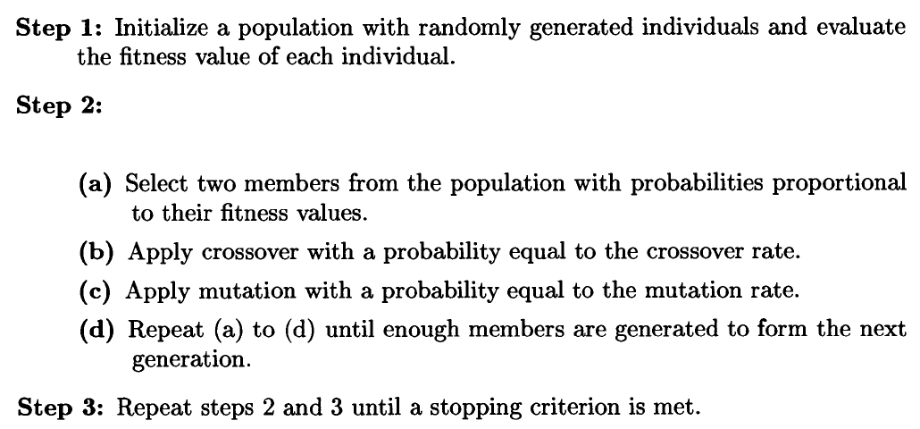
Based on previous discussion a simple genetic algorithm for maximization problems is described as,

